Slide 1
Invest in/For You

Slide 2
Puzzle
You bought a stock for ₹100 per share.
It rises 10% per day for 30 days.
On the 31st day, it crashes 90% in one day.

Slide 3
Puzzle Answer
A=P(1+r)n
A = Final amount
P = Initial price (₹100)
r = Growth rate per day (10% or 0.1)
n = Number of days (30)
Profit: A=1,745×0.10 =₹174.5
Loss: Loss=1,745×0.90 =₹1,570.5 total = 1745-1570 = 174.5

Slide 4
Importance of Insurance
Life is unpredictable
Medical emergencies can drain savings and push families into debt.
Medical inflation is 10-15% per year—treatment costs will only rise. A ₹5 lakh health cover today may not be enough in 10 years—insurance helps keep up with inflation.
Protects savings from unexpected medical emergencies.
Some policies offer cashless hospitalization, reducing immediate financial stress.

Slide 5
Term Insurance
Pays a lump sum to your family if you pass away. Ensures financial stability for dependents (spouse, children, parents).Helps cover loans, education costs, and daily expenses in your absence.
Premiums paid for health insurance qualify for tax deductions under Section 80D (India).

Slide 6
Few strategies while opting Insurance
Assess Your Needs – Evaluate your medical history, family needs, and expected healthcare expenses.
Check the Network – Ensure your preferred doctors, hospitals, and specialists are included in the insurer's network.
Review Claim Settlement Ratio – Choose an insurer with a high claim settlement ratio for hassle-free claim approval.
Look for No-Claim Bonus – Some insurers offer a bonus or discount for every claim-free year, reducing future premiums.
Check Waiting Periods – Understand the waiting period for pre-existing diseases, maternity, and specific treatments.
Read Exclusions Carefully – Be aware of what is not covered, such as specific diseases, alternative treatments, or lifestyle-related conditions.
Compare Online & Read Reviews – Use online tools to compare plans and read customer feedback to gauge service quality.

Slide 7


Slide 8
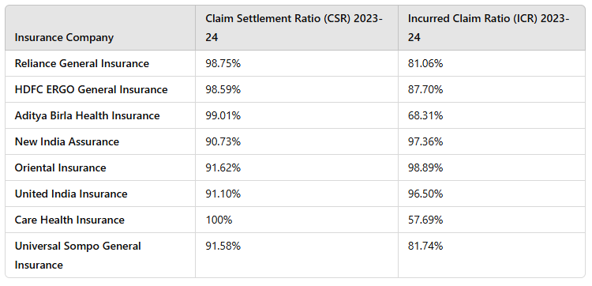
FY203-24

Slide 9
Mutual Funds
Mutual Funds: A mutual fund is an investment platform that funds money from several investors and invests these funds in several financial securities like bonds, stocks, shares, money market instruments, gold, etc.
Ways to invest in Mutual funds:
Lump Sum Investment (One-Time Investment)
How it works: You invest a large amount at once.
Best for: Investors with a big corpus looking for long-term growth.
Example: Investing ₹1 lakh in a mutual fund today.
Pros:
Higher potential returns if the market rises.
Suitable for long-term wealth creation.
Cons:
High market risk if invested at the wrong time.

Slide 10
Systematic Investment Plan (SIP) – Monthly Investing
How it works: You invest a fixed amount (e.g., ₹5,000) every month in a mutual fund.
Best for: Salaried individuals and those who want to invest gradually.
Example: Investing ₹5,000 every month for 10 years.
Pros:
Rupee Cost Averaging – Reduces the impact of market volatility.
Disciplined Investing – Helps in consistent wealth accumulation.
Cons:
Returns depend on market movements over time.
Systematic Transfer Plan (STP) – Moving Money from One Fund to Another
How it works: You invest a lump sum in a low-risk mutual fund (e.g., liquid fund) and gradually transfer a fixed amount into an equity mutual fund.
Best for: Investors who want better risk management when shifting to equities.
Example: Investing ₹5 lakh in a debt fund and transferring ₹10,000 per month to an equity fund.
Pros:
Reduces risk of investing a lump sum in equity at a market high.
Gives better returns than parking money in savings accounts.
Cons:
Involves exit load charges and tax implications.

Slide 11
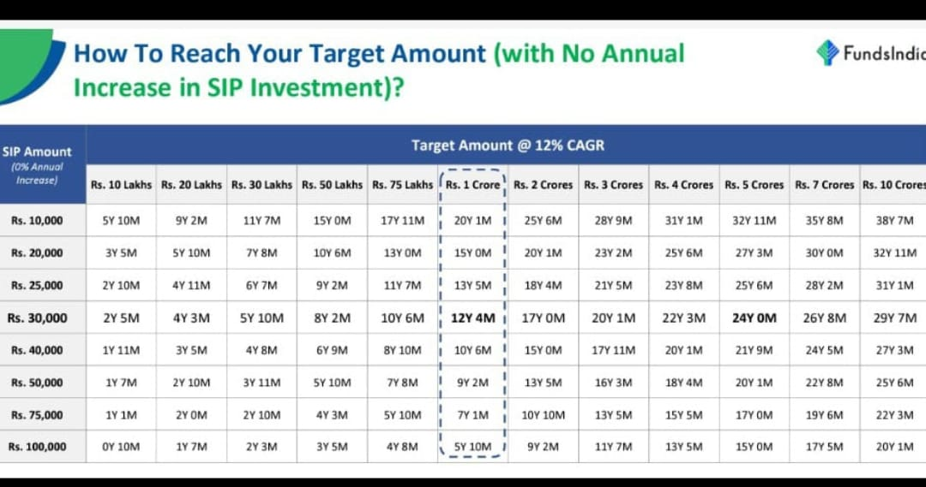

Slide 12
4. Systematic Withdrawal Plan (SWP) – Regular Income from Mutual Funds
How it works: You withdraw a fixed amount from a mutual fund at regular intervals.
Best for: Retirees or those looking for a steady income stream.
Example: Withdrawing ₹10,000 per month from a mutual fund investment.
Pros:
Regular income without liquidating the entire investment.
More tax-efficient than withdrawing lump sum gains.
Cons:
Can reduce the corpus if withdrawals are too high.

